Slide 1
Homomorphic Encryption Tutorial
Shai Halevi ― IBM
CRYPTO 2011

Slide 2
Computing on Encrypted Data
Wouldn’t it be nice to be able to…
Encrypt my data before sending to the cloud
While still allowing the cloud to search/sort/edit/… this data on my behalf
Keeping the data in the cloud in encrypted form
Without needing to ship it back and forth to be decrypted

Slide 3
Computing on Encrypted Data
Wouldn’t it be nice to be able to…
Encrypt my queries to the cloud
While still allowing the cloud to process them
Cloud returns encrypted answers
that I can decrypt

Slide 4


Computing on Encrypted Data
$skj#hS28ksytA@ …

Slide 5
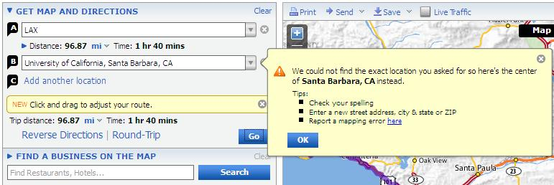

Computing on Encrypted Data
$kjh9*mslt@na0 &maXxjq02bflx m^00a2nm5,A4. pE.abxp3m58bsa (3saM%w,snanba nq~mD=3akm2,A Z,ltnhde83|3mz{n dewiunb4]gnbTa*
kjew^bwJ^mdns0

Slide 6
Organization of the Tutorial
Two parts with a 10-minute break in between
First part quite high-level
Lots of pictures/animations on the slides
Covers the [Gentry 2009] blueprint
Second part more algebraic
Lots of formulas on the slides
Covers newer constructions [GH’11,BV’11,BGV’11] (April 2011 and on)

Slide 7
Some Notations
An encryption scheme: (KeyGen, Enc, Dec)
Plaintext-space = {0,1}
(pk,sk) ←KeyGen($), c←Enc_{pk}(b), b←Dec_{sk}(c)
Semantic security [GM’84]: (pk, Enc_{pk}(0)) ≈ (pk, Enc_{pk}(1))
≈ means indistinguishable by efficient algorithms

Slide 8
Homomorphic Encryption (FHE)
H = {KeyGen, Enc, Dec, Eval}
c* ← Eval_{pk}(f, c)
Homomorphic: Dec_{sk}(Eval_{pk}( f, Enc_{pk}(x))) = f(x)
c* may not look like a “fresh” ciphertext
As long as it decrypts to f(x)
Compact: Decrypting c* easier than computing f
Otherwise we could use Eval_{pk} (f, c)=(f, c) and Dec_{sk}(f, c) = f(Dec_{sk}(c))
|c*| independent of the complexity of f
c*

Slide 9
Privacy Homomorphisms [RAD78]
Plaintext space P
Ciphertext space C
x₁ x₂
c_{i} ← Enc(x_{i})
c₁ c₂
∗
#
y ← Dec(d)
y
d
Some examples:
“Raw RSA”: c ← x^{e} mod N (x ← c^{d} mod N)
x₁e x x₂e = (x₁ x x₂) ^{e} mod N
GM84: Enc(0)∈_{R} QR, Enc(1)∈_{R} QNR (in Z_{N}*)
Enc(b₁) x Enc(b₂) = Enc(b₁⊕b₂) mod N

Slide 10
More Privacy Homomorphisms
Mult-mod-p [ElGamal’84]
Add-mod-N [Pallier’98]
Quadratic-polys mod p [BGN’06]
Branching programs [IP’07]
A different type of solution for any circuit [Yao’82,…]
Not compact, ciphertext grows with circuit complexity
Also NC1 circuits [SYY’00]

Slide 11
(x,+)-Homomorphic Encryption
It will be really nice to have…
Plaintext space Z₂ (w/ ops +,x)
Ciphertexts live in algebraic ring R (w/ ops +,x)
Homomorphic for both + and x
Enc(b₁) + Enc(b₂) in R = Enc(b₁+ b₂ mod 2)
Enc(b₁) x Enc(b₂) in R = Enc(b₁ x b₂ mod 2)
➔Can compute any function on the encryptions
Since every binary function is a polynomial
Won’t get exactly this, but it’s a good motivation

Slide 12

The [Gentry 2009] Blueprint

Slide 13
The [Gentry 2009] blueprint
Evaluate any function in four “easy” steps
Step 1: Encryption from linear ECCs
Additive homomorphism
Step 2: ECC lives inside a ring
Also multiplicative homomorphism
But only for a few operations (low-degree poly’s)
Step 3: Bootstrapping
Few ops (but not too few) ➔ any number of ops
Step 4: Everything else
“Squashing” and other fun activities
Error-Correcting Codes (not Elliptic-Curve Cryptography)

Slide 14
Step 1: Encryption from Linear ECCs
For “random looking” codes, hard to distinguish close/far from code
Many cryptosystems built on this hardness
E.g., [McEliece’78, AD’97, GGH’97, R’03,…]

Slide 15
Step 1: Encryption from Linear ECCs
KeyGen: choose a “random” Code
Secret key: “good representation” of Code
Allows correction of “large” errors
Public key: “bad representation” of Code
Can generate “random code-words”
Hard to distinguish close/far from the code
Enc(0): a word close to Code
Enc(1): a random word
Far from Code (with high probability)

Slide 16
Example: Integers mod p [vDGHV 2010]
p
N
Code determined by a secret integer p
Codewords: multiples of p
Good representation: p itself
Bad representation:
N = pq, and also many x_{i} = pq_{i} + r_{i}
Enc(0): subset-sum(x_{i}’s)+r mod N
r is new noise, chosen by encryptor
Enc(1): random integer mod N
r_{i} << p

Slide 17
A Different Input Encoding
p
N
x_{i} = pq_{i} + r_{i}
Both Enc(0), Enc(1) close to the code
Enc(0): distance to code is even
Enc(1): distance to code is odd
Security unaffected when p is odd
In our example of integers mod p:
Enc(b) = 2(r+subset-sum(x_{i}’s)) + b mod N = κp + 2(r+subset-sum(r_{i}’s))+b
Dec(c) = (c mod p) mod 2
Plaintext encoded
in the “noise”
much smaller than p/2

Slide 18
Additive Homomorphism
c₁+c₂ = (codeword₁+codeword₂) + (2r₁+b₁)+(2r₂+b₂ )
codeword₁+codeword₂ ∈ Code
(2r₁+b₁)+(2r₂+b₂ )=2(r₁+r₂)+b₁+b₂ is still small
If 2(r₁+r₂)+b₁+b₂ < min-dist/2, then dist(c₁+c₂, Code) = 2(r₁+r₂)+b₁+b₂
➔ dist(c₁+c₂, Code) ≡ b₁+b₂ (mod 2)
Additively-homomorphic while close to Code

Slide 19
Step 2: Code Lives in a Ring
What happens when multiplying in Ring:
c₁∙c₂ = (codeword₁+2r₁+b₁)∙(codeword₂+2r₂+b₂) = codeword₁∙X + Y∙codeword₂ + (2r₁+b₁)∙(2r₂+b₂)
If:
codeword₁∙X + Y∙codeword₂ ∈ Code
(2r₁+b₁)∙(2r₂+b₂) < min-dist/2
Then
dist(c₁c₂, Code) = (2r₁+b₁)∙(2r₂+b₂) = b₁∙b₂ mod 2
Code is an ideal
Product in Ring of small elements is small

Slide 20
Example: Integers mod p [vDGHV 2010]
p
N
x_{i} = pq_{i} + r_{i}
Secret-key is p, public-key is N and the x_{i}’s
c_{i} = Enc_{pk}(b_{i}) = 2(r+subset-sum(x_{i}’s)) + b mod N = k_{i}p + 2r_{i}+b_{i}
Dec_{sk}(c_{i}) = (c_{i} mod p) mod 2
c₁+c₂ mod N = (k₁p+2r₁+b₁)+(k₂p+2r₂+b₂) – kqp = k’p + 2(r₁+r₂) + (b₁+b₂)
c₁c₂ mod N = (k₁p+2r₁+b₁)(k₂p+2r₂+b₂) – kqp = k’p + 2(2r₁r₂+r₁b₂+r₂b₁)+b₁b₂
Additive, multiplicative homomorphism
As long as noise < p/2

Slide 21
Summary Up To Now
We need a linear error-correcting code C
With “good” and “bad” representations
C lives inside an algebraic ring R
C is an ideal in R
Sum, product of small elements in R is still small
Can find such codes in Euclidean space
Often associated with lattices
Then we get a “somewhat homomorphic” encryption, supporting low-degree polynomials
Homomorphism while close to the code

Slide 22
Instantiations
[G 2009] Polynomial Rings
Security based on hardness of “Bounded-Distance Decoding” in ideal lattices
[vDGHV 2010] Integer Ring
Security based on hardness of the “approximate-GCD” problem
[GHV 2010] Matrix Rings (only partial solution)
Only qudratic polynomials, security based on hardness of “Learning with Errors” (LWE)
[BV 2011a] Polynomial Rings
Security based on “ring LWE”

Slide 23
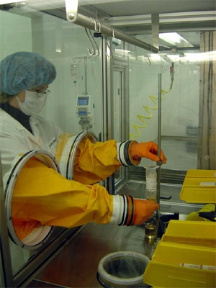
Step 3: Bootstrapping
So far, can evaluate low-degree polynomials
x₁
P
x₂
…
P(x₁, x₂ ,…, x_{t})
x_{t}
Notes:
Explain “fresh” vs “evaluated” cipehrtexts

Slide 24
Step 3: Bootstrapping
So far, can evaluate low-degree polynomials
Can eval y=P(x₁,x₂…,x_{n}) when x_{i}’s are “fresh”
But y is an “evaluated ciphertext”
Can still be decrypted
But eval Q(y) will increase noise too much
“Somewhat Homomorphic” encryption (SWHE)
x₁
P
x₂
…
P(x₁, x₂ ,…, x_{t})
x_{t}
Notes:
Explain “fresh” vs “evaluated” cipehrtexts

Slide 25
Step 3: Bootstrapping
So far, can evaluate low-degree polynomials
Bootstrapping to handle higher degrees
We have a noisy evaluated ciphertext y
Want to get another y with less noise
x₁
P
x₂
…
P(x₁, x₂ ,…, x_{t})
x_{t}
Notes:
Explain “fresh” vs “evaluated” cipehrtexts

Slide 26
Step 3: Bootstrapping
For ciphertext c, consider D_{c}(sk) = Dec_{sk}(c)
Hope: D_{c}(∗) is a low-degree polynomial in sk
Include in the public key also Enc_{pk}(sk)
Homomorphic computation applied only to the “fresh” encryption of sk
c
y
Requires “circular security”
sk₁
Dc
sk₁
sk₂
sk₂
c’
…
Dc(sk)
…
= Dec_{sk}(c) = y
sk_{n}
sk_{n}

Slide 27
Step 3: Bootstrapping
Similarly define Mc₁,c₂(sk) = Dec_{sk}(c₁)∙Dec_{sk}(c₁)
Homomorphic computation applied only to the “fresh” encryption of sk
y₁
y₂
c₁
c₂
sk₁
Mc₁,c₂
sk₁
c’
sk₂
sk₂
…
Mc₁,c₂(sk)
…
= Dec_{sk}(c₁) x Dec_{sk}(c₂) = y₁ x y₂
sk_{n}
sk_{n}

Slide 28

Step 4: Everything Else
Cryptosystems from [G’09, vDGHV’10, BG’11a] cannot handle their own decryption
Tricks to “squash” the decryption procedure, making it low-degree
Nontrivial, requires putting more information about the secret key in the public key
Requires yet another assumption, namely hardness of the Sparse-Subset-Sum Problem (SSSP)
I will not talk about squashing here

Slide 29
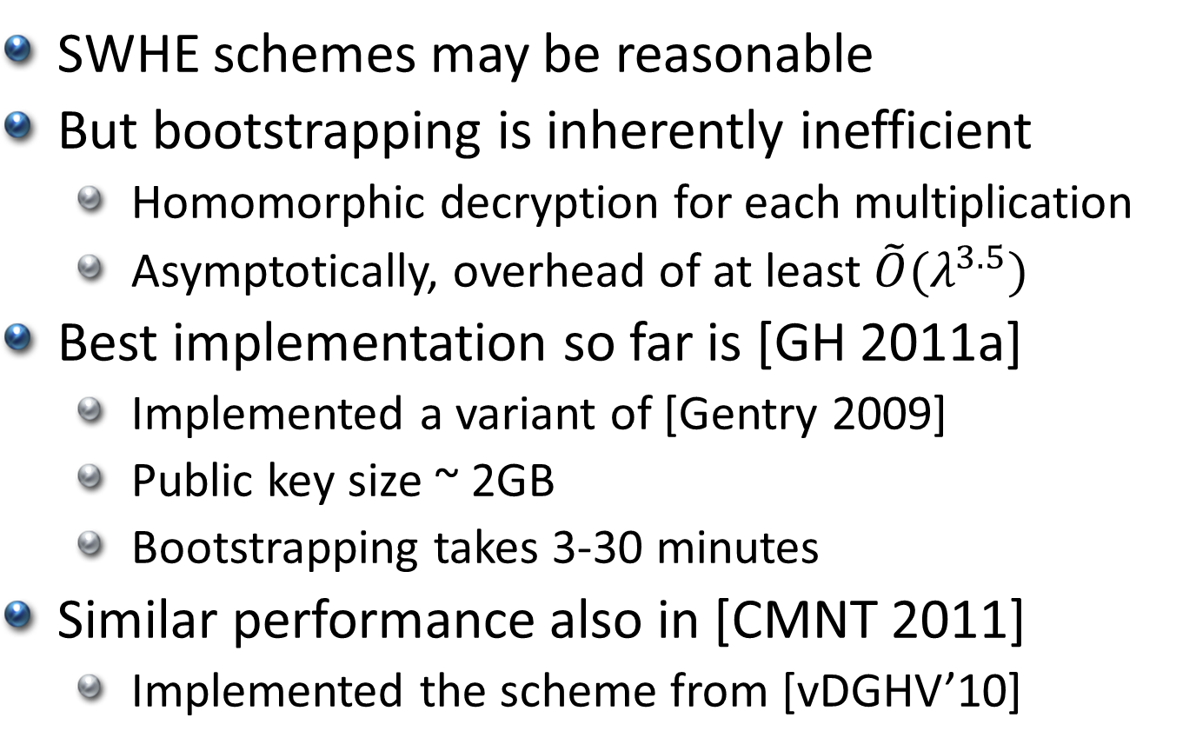
Performance of Blueprint
SWHE schemes may be reasonable
But bootstrapping is inherently inefficient
Homomorphic decryption for each multiplication
Asymptotically, overhead of at least $\tilde{O}(λ^{3.5})$
Best implementation so far is [GH 2011a]
Implemented a variant of [Gentry 2009]
Public key size ~ 2GB
Bootstrapping takes 3-30 minutes
Similar performance also in [CMNT 2011]
Implemented the scheme from [vDGHV’10]

Slide 30

Beyond the Blueprint

Slide 31
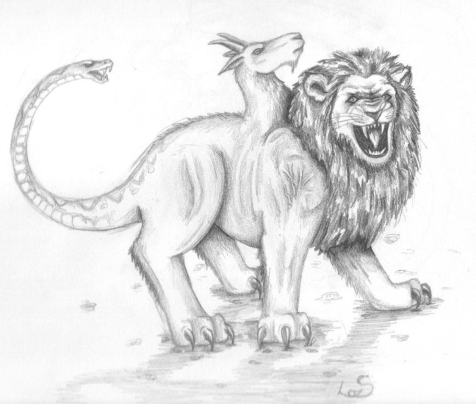
Chimeric HE [GH 2011b]
Bootstrapping without squashing
Hybrid of SWHE and MHE schemes
MHE = Multiplicative HE (e.g., Elgamal)
Express decryption as a “restricted depth-3” ΣΠΣ arithmetic circuit
Switch to MHE for the middle Π level
All necessary MHE ciphertexts found in public key
Translate back to SWHE for the top Σ level
SWHE evaluates MHE decryption, not own decryption
No need for squashing, SSSP
+
X
X
X
+
+
+
+
+
+
+
+
+

Slide 32
[Brakerski-Vaikuntanathan 2011b]
FHE without squashing, security based on Learning-with-Errors (LWE), or ring-LWE
Main innovation: multiplicative homomorphism without a ring structure
A host of new techniques/tricks, can be used for further improvements

Slide 33
Learning with Errors (LWE) [Regev 2005]
Hard to solve linear equations with noise
Given:
decide if
b is a random vector in Z_{q}^{m}, or
b is close to the row-space of A (distance < βq)
b = sA + e for random s∈ Z_{q}^{n} and random short e∈ Z_{q}^{m}
Parameters: n (dim), q≥poly(n) (modulus), β≤1/poly(n) (noise magnitude), m = poly(n)
[Regev’05, Peikert’09]: As hard as some worst-case lattice problems in dim n (for certain range of params)
∈ Z_{q}^{m}
b
A
∈_{R} Z_{q}^{nxm}

Slide 34
The [BV’11b] Construction
Bit-by-bit encryption, plaintext is a bit b
Think of it as symmetric encryption for now
Secret-key s, ciphertext c, are vectors in Z_{q}^{n}
Simplifying convention: s₁ = 1, i.e., s = (1|t)
Decryption is b=(<s,c> mod q) mod 2
(<s,c> mod q) is small, absolute value ≤ βq
In other words:
Ciphertexts are “close” to space orthogonal to s
Plaintext encoded in parity of “distance”
“distance” is the size of (<s,c> mod q)
mod q maps to [-q/2, q/2]

Slide 35

Homomorphism
This is an instance of encryption from linear ECCs, additive homomorphism is “for free”
As long as things remain close to the code
But how to multiply?
Ciphertexts are vectors, not ring elements
Tensor product (??)
Can decrypt M(!), s(u⊗v)s^{t} = <s,u>·<s,v> (mod q)
If no wraparound then (s(u⊗v)s^{t} mod q) = (<s,u> mod q)·(<s,v> mod q)
So (s(u⊗v)s^{t} mod q) mod 2 = Dec_{s}(u)·Dec_{s}(v)
M = u⊗v, M_{ij} = u_{i} · v_{j} mod q

Slide 36
Multiplying More than Once?
s(u⊗v)s^{t} is a bilinear form in s, so linear in s⊗s
Opening u⊗v, s⊗s into vectors, we get s(u⊗v)s^{t} = <vec(s⊗s),vec(u⊗v)>
Denote s*=vec(s⊗s), c*=vec(u⊗v), then:
Dec_{s*}(c*) = (<s*,c*> mod q) mod 2
<s*,c*> mod q is still quite small, ≤ (βq)² << q
We can repeat the process
But dimension is squared, n → n² → n⁴ → n⁸ … so can repeat only a constant number of times

Slide 37
Reducing the Dimension
We have an “extended ciphertext” c* with respect to “extended secret key” s*=vec(s⊗s)
Want a low-dimension ciphertext c’ with respect to a “standard secret key” s’
Maybe s’=s, maybe not
Key idea: publish “an encryption” of s* under s’ to enable the translation
Hopefully just a matrix M(s*→s’)∈Z_{q}^{dim(s’)x dim(s*)}, so that c’ = M·c*∈Z_{q}^{dim(s’)}

Slide 38
An Attempt that Almost Works
= -t’A+(2e+s*) mod q
b
M=
A
e is short
∈_{R} Z_{q}^{dim(t’) x dim(s*)}
Recall s’=(1|t’), so s’M= t’A+b = 2e+s*
Let c’ = M·c*∈Z_{q}^{dim(s’)}, then mod q we have:
<s’,c’> ≡ s’Mc* ≡ <2e+s*,c*> ≡ <s*,c*>+2<e,c*>
If only c* was short, then 2<e,c*> was small, so (<2e+s*,c*> mod q) = (<s*,c*> mod q)+2<e,c*>
Hence (<s’,c’> mod q) ≡ (<s*,c*> mod q) (mod 2)
So Dec_{s’}(c’) = Dec_{s*} (c*)

Slide 39
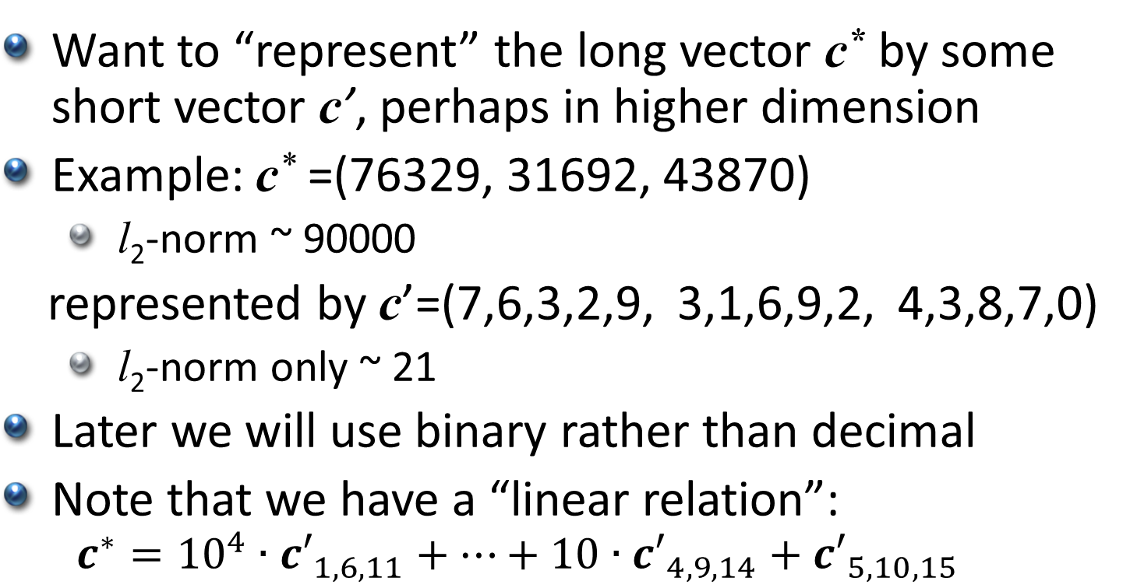
Can we Make c* Short?
Want to “represent” the long vector c* by some short vector c’, perhaps in higher dimension
Example: c* =(76329, 31692, 43870)
l₂-norm ~ 90000
represented by c’=(7,6,3,2,9, 3,1,6,9,2, 4,3,8,7,0)
l₂-norm only ~ 21
Later we will use binary rather than decimal
Note that we have a “linear relation”:
$$c^{∗}={10}^{4}∙{c′}_{1,6,11}+⋯+10∙{c′}_{4,9,14}+{c′}_{5,10,15}$$

Slide 40
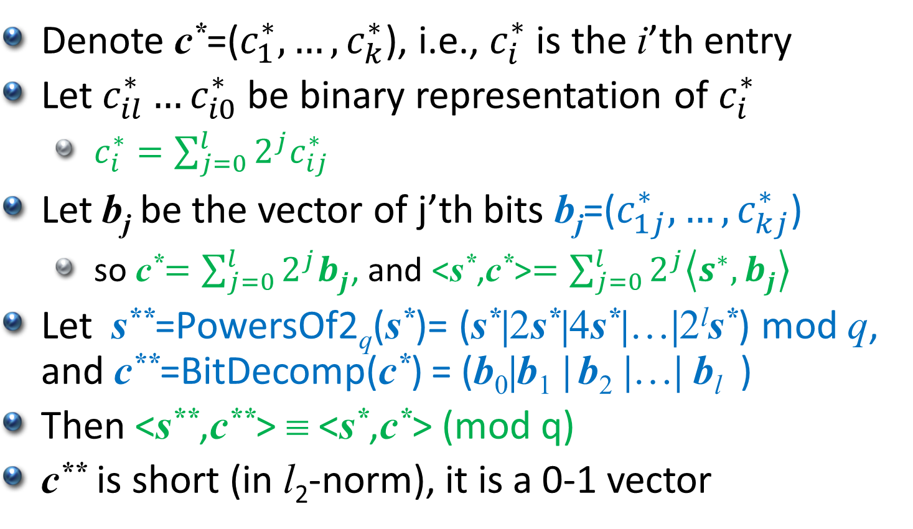
Can we Make c* Short?
Denote c*=($c_{1}^{∗},…,c_{k}^{∗}$), i.e., $c_{i}^{∗}$ is the i’th entry
Let $c_{il}^{∗}…c_{i0}^{∗}$ be binary representation of $c_{i}^{∗}$
$c_{i}^{∗}=\sum_{j=0}^{l}{2^{j}c_{ij}^{∗}}$
Let b_{j} be the vector of j’th bits b_{j}=($c_{1j}^{∗},…,c_{kj}^{∗}$)
so c*$=\sum_{j=0}^{l}{2^{j}b_{j}^{}}$, and <s*,c*>$=\sum_{j=0}^{l}{2^{j}\left\langle s_{}^{∗},b_{j}^{}\right\rangle }$
Let s**=PowersOf2_{q}(s*)= (s*|2s*|4s*|…|2^{l}s*) mod q, and c**=BitDecomp(c*) = (b₀|b₁ | b₂ |…| b_{l} )
Then <s**,c**> ≡ <s*,c*> (mod q)
c** is short (in l₂-norm), it is a 0-1 vector

Slide 41
Dimension Reduction (Key-Switching)
Publish the matrix M(s**→s’)∈Z_{q}^{dim(s’) x dim(s**)}
Given the expanded ciphertext c*
Compute the “doubly expanded” c**
Set c’ = M·c** mod q
We know that <s**,c**> ≡ <s*,c*> (mod q)
Also <s’,c’> ≡ <s**,c**>+2<e,c**> (mod q)
(<s*,c*> mod q) is small and so is 2<e,c**> hence (<s’,c’> mod q) = (<s*,c*>+2<e,c**> mod q)
Last equality is over the integers
➔ Dec_{s’}(c’) = Dec_{s*} (c*)

Slide 42
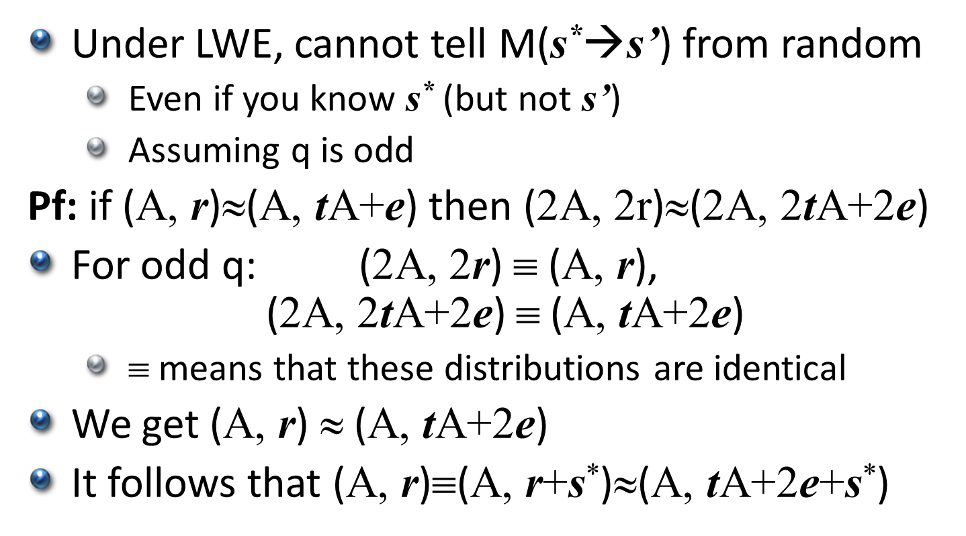
Security
−t’A+2e+s*
M(s*→s’)=
A
Under LWE, cannot tell M(s*→s’) from random
Even if you know s* (but not s’)
Assuming q is odd
Pf: if (A, r)≈(A, tA+e) then (2A, 2r)≈(2A, 2tA+2e)
For odd q: (2A, 2r) ≡ (A, r), (2A, 2tA+2e) ≡ (A, tA+2e)
$$ means that these distributions are identical
We get (A, r) ≈ (A, tA+2e)
It follows that (A, r)≡(A, r+s*)≈(A, tA+2e+s*)

Slide 43
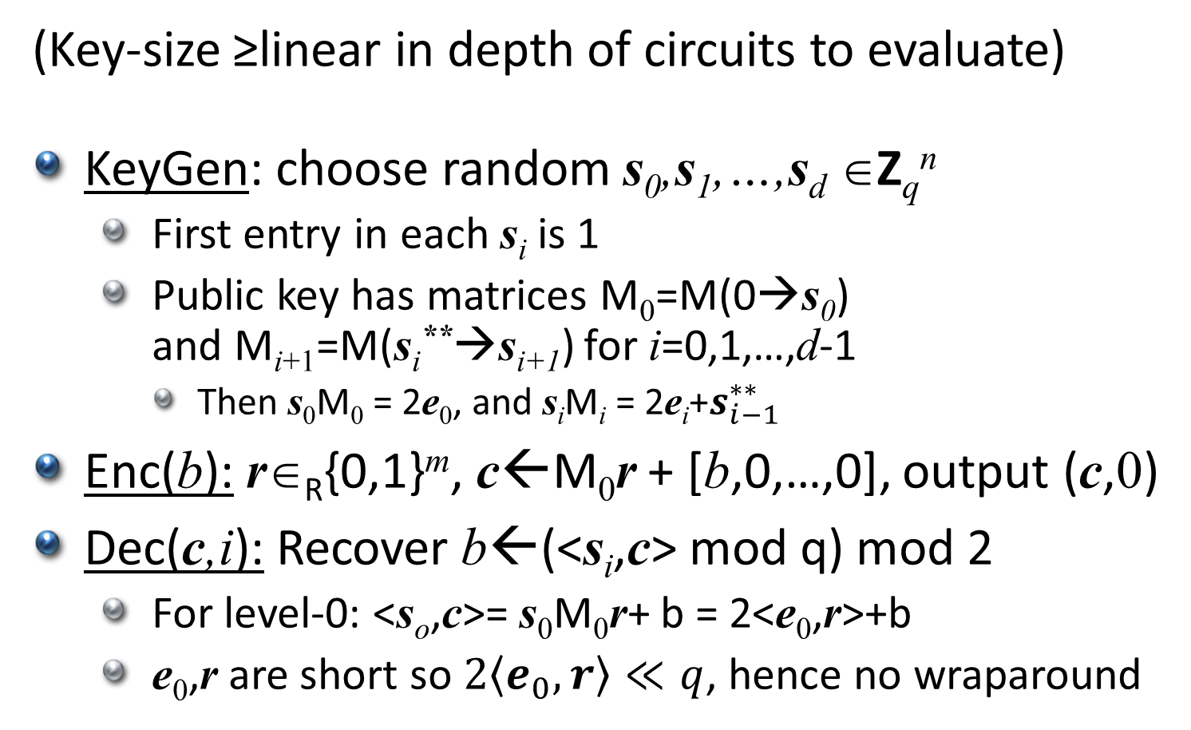
The [BV’11b] “Leveled SWHE”
(Key-size ≥linear in depth of circuits to evaluate)
KeyGen: choose random s₀,s₁,…,s_{d} ∈Z_{q}^{n}
First entry in each s_{i} is 1
Public key has matrices M₀=M(0→s₀) and M_{i+1}=M(s_{i}**→s_{i+1}) for i=0,1,…,d-1
Then s₀M₀ = 2e₀, and s_{i}M_{i} = 2e_{i}+$s_{i−1}^{∗∗}$
Enc(b): r∈_{R}{0,1}^{m}, c←M₀r + [b,0,…,0], output (c,0)
Dec(c,i): Recover b←(<s_{i},c> mod q) mod 2
For level-0: <s_{o},c>= s₀M₀r+ b = 2<e₀,r>+b
e₀,r are short so $2\left\langle e_{0},r\right\rangle ≪q$, hence no wraparound

Slide 44
The [BV’11b] “Leveled SWHE”
Ciphertexts in same level can be added directly
To multiply two level-i ciphertexts (c₁,i),(c₂,i)
Compute the extended c*=vec(c₁⊗c₂), the “doubly extended” c**, and set c’←M_{i}c**
(c’,i+1) is a level-(i+1) ciphertext
Semantic-security follows because:
Under LWE, the M_{i}’s are pseudo-random
If they were random then ciphertexts would have no information about the encrypted plaintexts
By leftover hash lemma

Slide 45
From SWHE to FHE
The “noise” in a ciphertext (c,i) is <s_{i},c> mod q
Noise magnitude roughly doubles on addition, get squared on multiplication
Can only evaluate log-depth circuits before the noise magnitude exceeds q
How to evaluate deeper circuits?
Squash & bootstrap,
Chimeric & bootstrap,
or an altogether new technique…

Slide 46
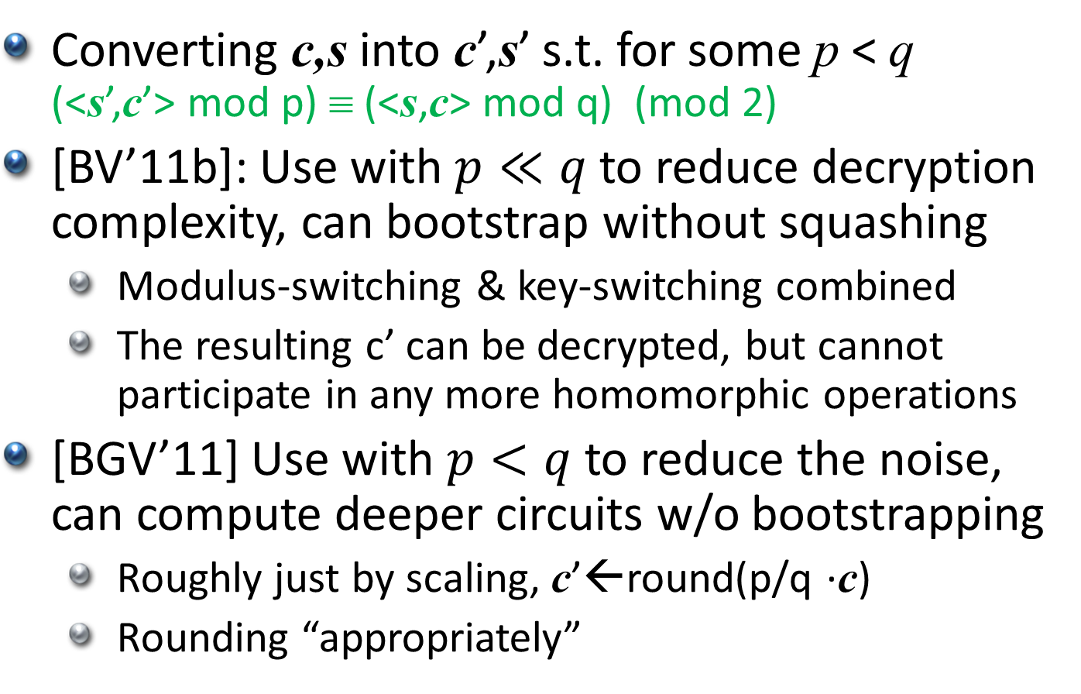
Modulus Switching
Converting c,s into c’,s’ s.t. for some p < q (<s’,c’> mod p) ≡ (<s,c> mod q) (mod 2)
[BV’11b]: Use with $p≪q$ to reduce decryption complexity, can bootstrap without squashing
Modulus-switching & key-switching combined
The resulting c’ can be decrypted, but cannot participate in any more homomorphic operations
[BGV’11] Use with $p<q$ to reduce the noise, can compute deeper circuits w/o bootstrapping
Roughly just by scaling, c’←round(p/q ·c)
Rounding “appropriately”

Slide 47
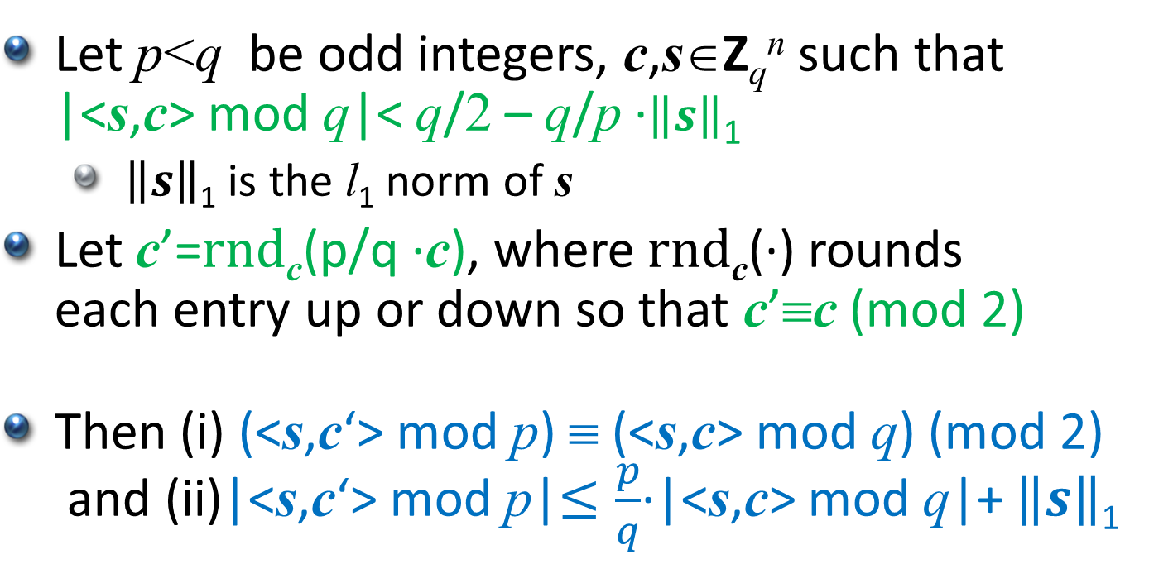
Modulus Switching – Main Lemma
Let p<q be odd integers, c,s∈Z_{q}^{n} such that |<s,c> mod q|< q/2 – q/p ·$\left\|s\right\|$₁
$\left\|s\right\|$₁ is the l₁ norm of s
Let c’=rnd_{c}(p/q ·c), where rnd_{c}(·) rounds each entry up or down so that c’≡c (mod 2)
Then (i) (<s,c‘> mod p) ≡ (<s,c> mod q) (mod 2) and (ii)|<s,c‘> mod p|$≤\frac{p}{q}$·|<s,c> mod q|+ $\left\|s\right\|$₁
s must be short

Slide 48
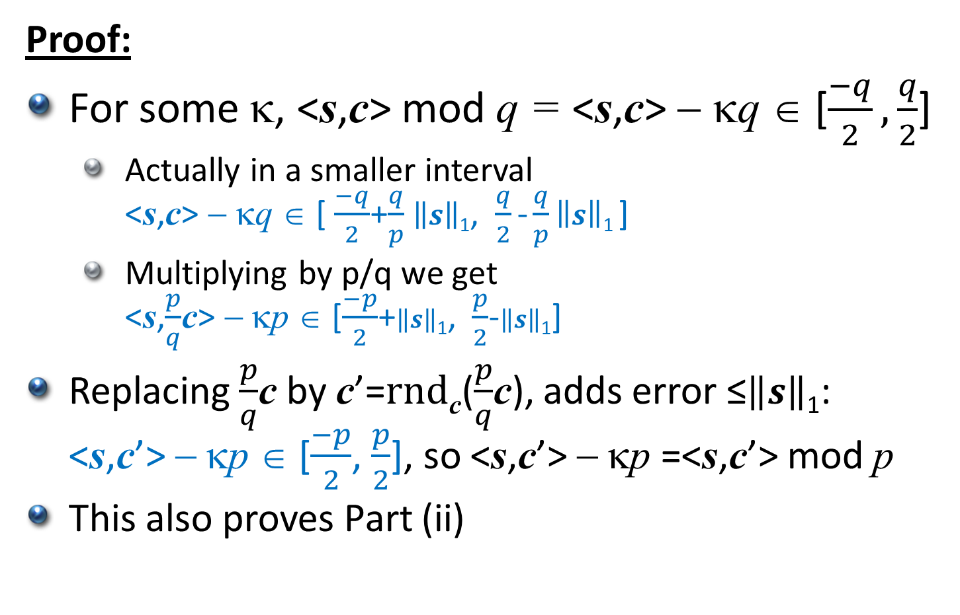
Modulus Switching – Main Lemma
Proof:
For some κ, <s,c> mod q = <s,c> − κq ∈ [$\frac{−q}{2},\frac{q}{2}$]
Actually in a smaller interval <s,c> − κq ∈ [ $\frac{−q}{2}$+$\frac{q}{p}$ $\left\|s\right\|$₁, $\frac{q}{2}$ - $\frac{q}{p}\left\|s\right\|$₁ ]
Multiplying by p/q we get <s,$\frac{p}{q}$c> − κp ∈ [$\frac{−p}{2}$+$\left\|s\right\|$₁, $\frac{p}{2}$-$\left\|s\right\|$₁]
Replacing $\frac{p}{q}$c by c’=rnd_{c}($\frac{p}{q}$c), adds error ≤$\left\|s\right\|$₁: <s,c’> − κp ∈ [$\frac{−p}{2}$, $\frac{p}{2}$], so <s,c’> − κp =<s,c’> mod p
This also proves Part (ii)

Slide 49
Modulus Switching – Main Lemma
Proof:
We know that <s,c> mod q = <s,c> − κq and <s,c’> mod p = <s,c’> − κp for the same κ
Since p,q are odd then κp≡ κq (mod 2)
Since c’≡c (mod 2) then <s,c’>≡<s,c> (mod 2)
(<s,c‘> mod p) = <s,c’> − κp ≡ <s,c> − κq (mod 2) = (<s,c> mod q)
This proves part (i)

Slide 50
Making s Small
If s is random in Z_{q}^{n} then ||s||₁ > q
Luckily [ACPS 2009] proved that LWE is hard even when s is a random short vector
chosen from the same distribution as the noise e
So we use this distribution for the secret keys
Alternatively, we could have used the trick with BitDecomp() and PowersOf2()

Slide 51
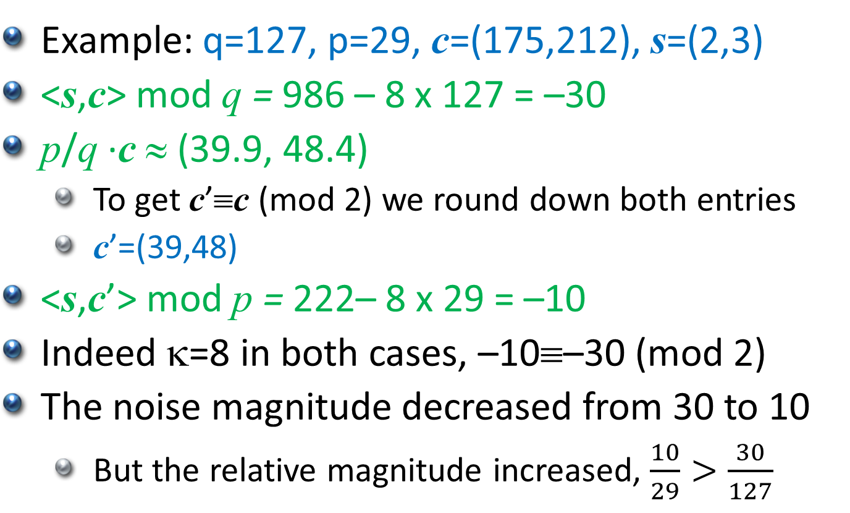
Modulus Switching
Example: q=127, p=29, c=(175,212), s=(2,3)
<s,c> mod q = 986 – 8 x 127 = –30
p/q ·c ≈ (39.9, 48.4)
To get c’≡c (mod 2) we round down both entries
c’=(39,48)
<s,c’> mod p = 222– 8 x 29 = –10
Indeed κ=8 in both cases, –10≡–30 (mod 2)
The noise magnitude decreased from 30 to 10
But the relative magnitude increased, $\frac{10}{29}>\frac{30}{127}$

Slide 52
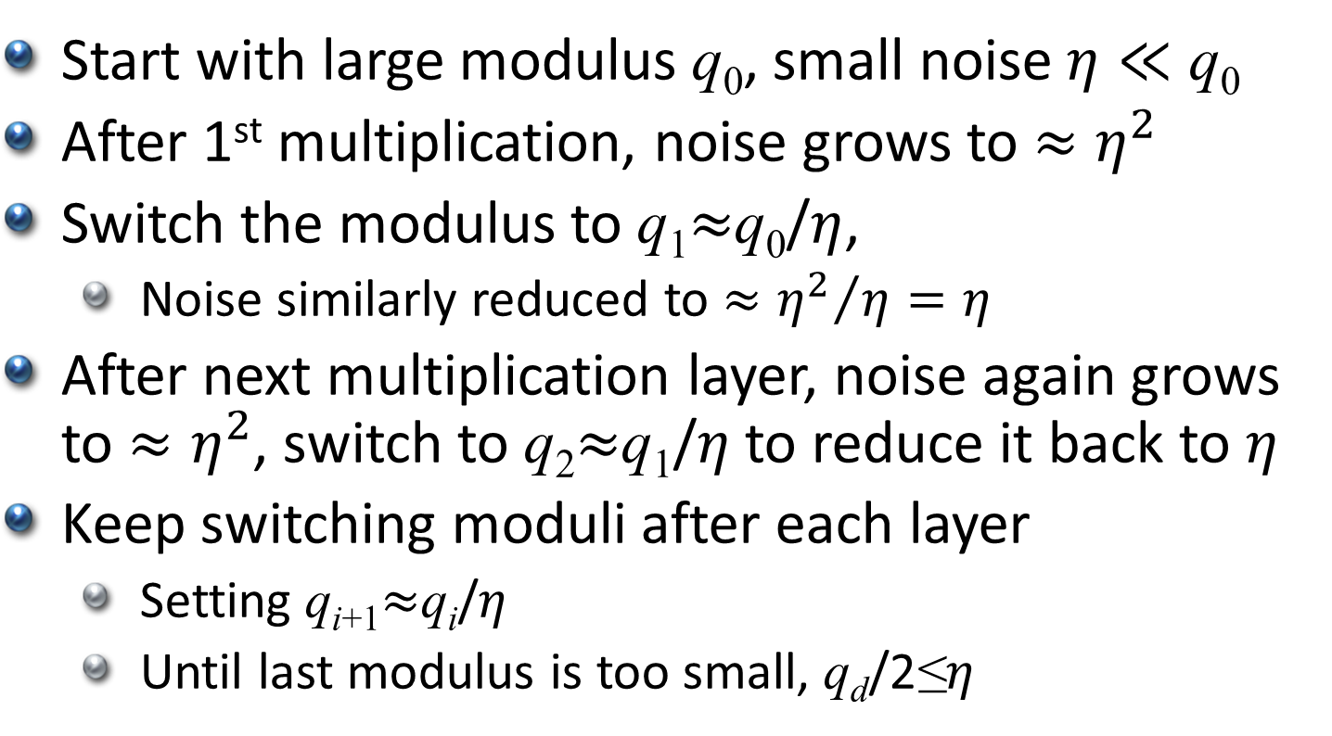
How Does Modulus-Switching Help?
Start with large modulus q₀, small noise $η≪$ q₀
After 1st multiplication, noise grows to $≈η^{2}$
Switch the modulus to q₁$≈$q₀/$η$,
Noise similarly reduced to $≈{η^{2}}/η=η$
After next multiplication layer, noise again grows to $≈η^{2}$, switch to q₂$≈$q₁/$η$ to reduce it back to $η$
Keep switching moduli after each layer
Setting q_{i+1}$≈$q_{i}/$η$
Until last modulus is too small, q_{d}/2≤$η$

Slide 53

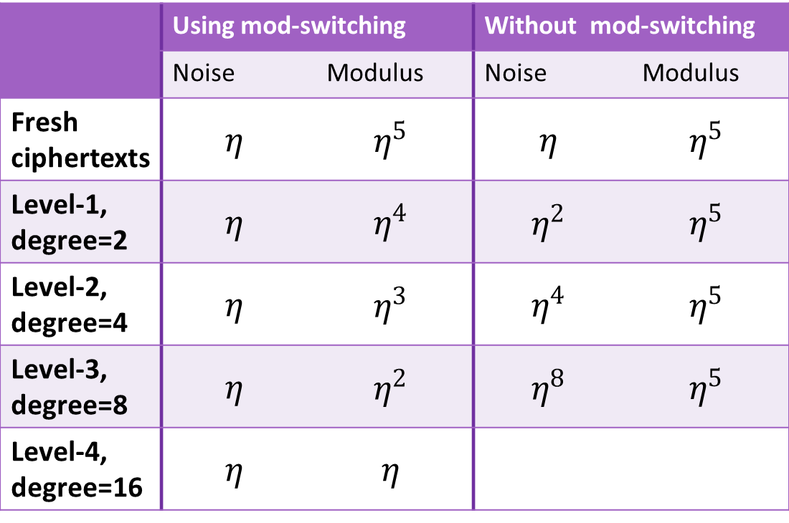
How Does Modulus-Switching Help?
Example: q₀$≈η^{5}$
 | Using mod-switching |  | Without mod-switching
 | Noise | Modulus | Noise | Modulus
Fresh ciphertexts | $$η$$ | $$η^{5}$$ | $$η$$ | $$η^{5}$$
Level-1, degree=2 | $$η$$ | $$η^{4}$$ | $$η^{2}$$ | $$η^{5}$$
Level-2, degree=4 | $$η$$ | $$η^{3}$$ | $$η^{4}$$ | $$η^{5}$$
Level-3, degree=8 | $$η$$ | $$η^{2}$$ | $$η^{8}$$ | $$η^{5}$$
Level-4, degree=16 | $$η$$ | $$η$$
decryption errors

Slide 54
Putting It All Together
Use tensor-product for multiplication
Then reduce the dimension with M(s→s’)
First need to use PowersOf2/BitDecomp
Then reduce the noise by switching modulus
This works if the secret key s is short
Repeat until modulus is too small

Slide 55
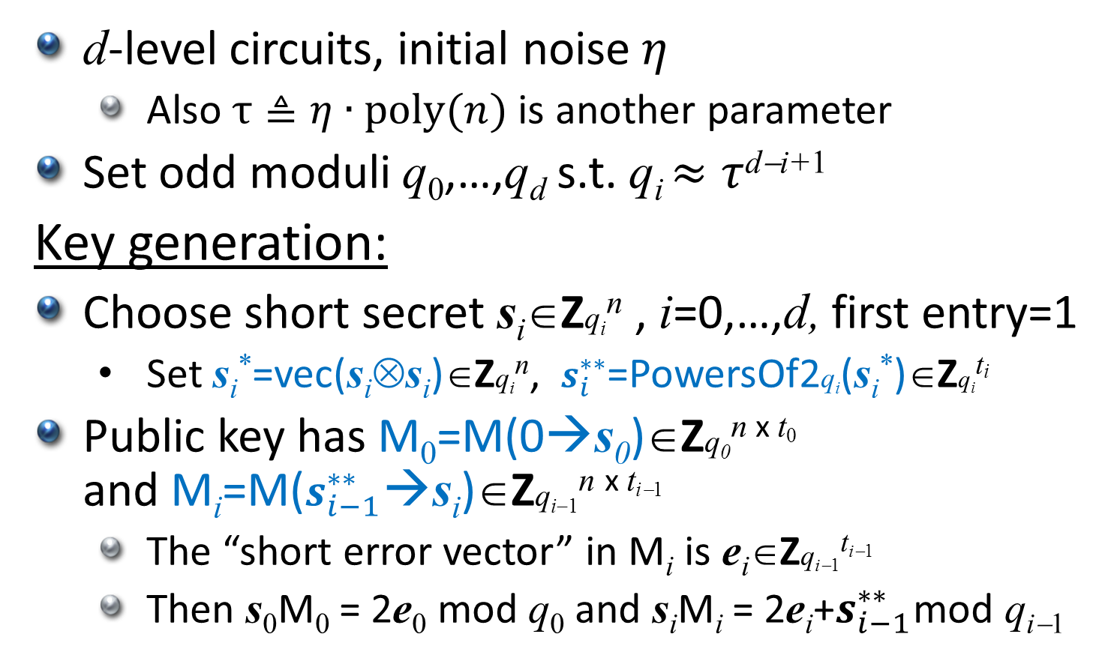
The [BGV’11] “Leveled FHE”
d-level circuits, initial noise $η$
Also $τ≜η∙poly(n)$ is another parameter
Set odd moduli q₀,…,q_{d} s.t. q_{i} $≈τ$^{d−i+1}
Key generation:
Choose short secret s_{i}∈Zq_{i}^{n} , i=0,…,d, first entry=1
Set s_{i}*=vec(s_{i}⊗s_{i})∈Zq_{i}^{n}, $s_{i}^{∗∗}$=PowersOf2q_{i}(s_{i}*)∈Zq_{i}^{ti}
Public key has M₀=M(0→s₀)∈Zq₀^{n x t0} and M_{i}=M($s_{i−1}^{∗∗}$→s_{i})∈Zq_{i−1}^{n x ti−1}
The “short error vector” in M_{i} is e_{i}∈Zq_{i−1}^{ti−1}
Then s₀M₀ = 2e₀ mod q₀ and s_{i}M_{i} = 2e_{i}+$s_{i−1}^{∗∗}$mod q_{i−1}
2
t₀=3nlog(q₀) and t_{i}=n²log(q_{i})

Slide 56
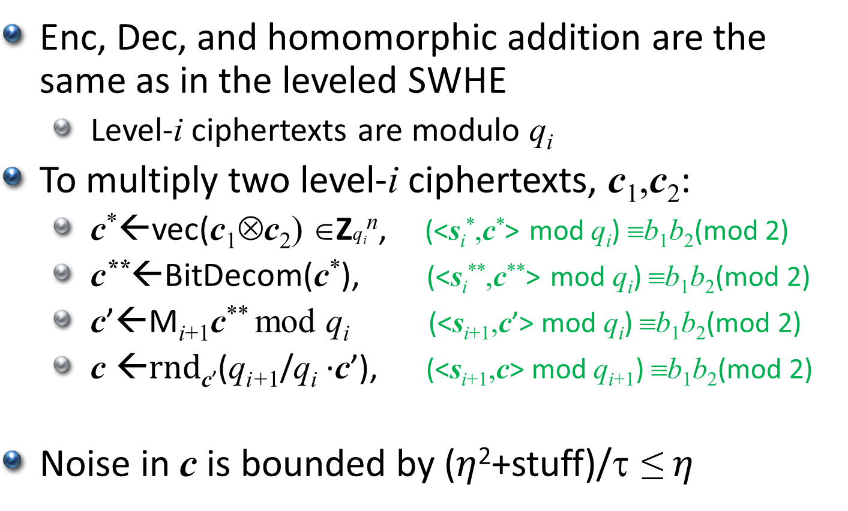
The [G’11] “Leveled FHE”
Enc, Dec, and homomorphic addition are the same as in the leveled SWHE
Level-i ciphertexts are modulo q_{i}
To multiply two level-i ciphertexts, c₁,c₂:
c*←vec(c₁⊗c₂) ∈Zq_{i}^{n}, (<s_{i}*,c*> mod q_{i}) ≡b₁b₂(mod 2)
c**←BitDecom(c*), (<s_{i}**,c**> mod q_{i}) ≡b₁b₂(mod 2)
c’←M_{i+1}c** mod q_{i} (<s_{i+1},c’> mod q_{i}) ≡b₁b₂(mod 2)
$\text{c} \text{←}$rnd_{c’}(q_{i+1}/q_{i} ·c’), (<$\text{s}\text{i}\text{+1}\text{,}\text{c}$> mod q_{i+1}) ≡b₁b₂(mod 2)
Noise in c is bounded by ($η$²+stuff)/τ ≤ $η$
2

Slide 57
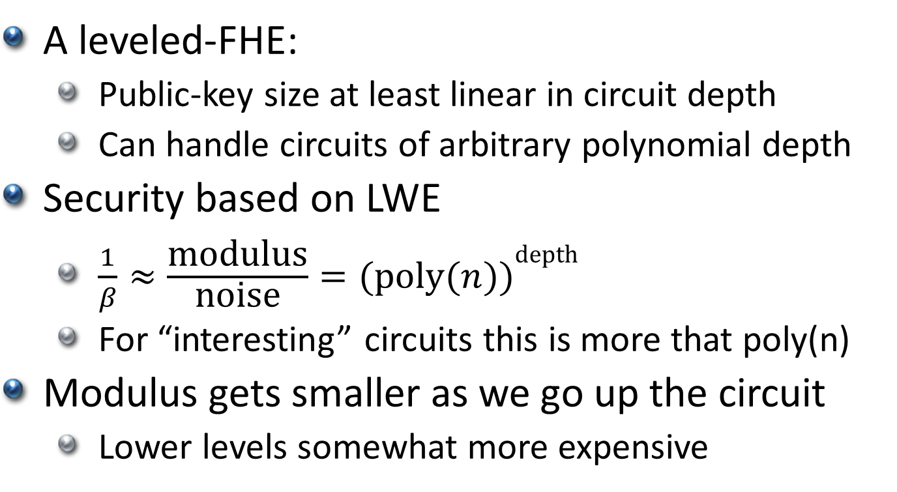
What We Have So Far
A leveled-FHE:
Public-key size at least linear in circuit depth
Can handle circuits of arbitrary polynomial depth
Security based on LWE
$\frac{1}{β}≈\frac{\text{modulus}}{\text{noise}}={(\text{poly}(n))}^{\text{depth}}$
For “interesting” circuits this is more that poly(n)
Modulus gets smaller as we go up the circuit
Lower levels somewhat more expensive

Slide 58
Variants and Optimizations
Use bootstrapping to recover large modulus
Size of largest modulus depends on decryption circuit, not the circuits that we evaluate
Can be made into “pure” FHE (non-leveled), need to assume circular security
Base security on ring-LWE
LWE over a ring other than Z_{q} (e.g., R=Z_{q}[x]/f(x))
Can use smaller dimension (e.g., dim=2)
Large plaintext space (not just Z₂)
Must tweak the modulus-switching technique

Slide 59
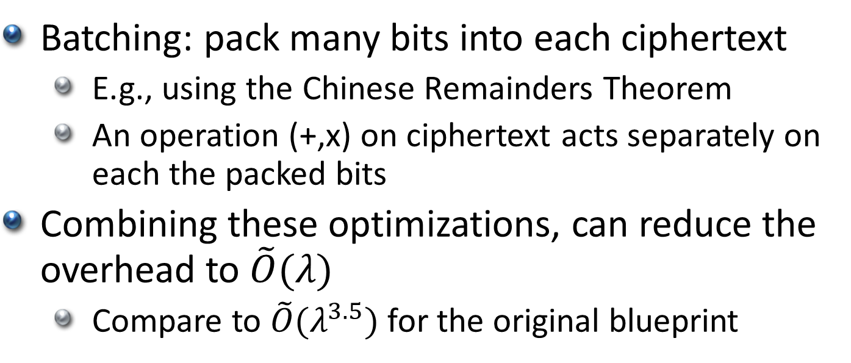
Variants and Optimizations
Batching: pack many bits into each ciphertext
E.g., using the Chinese Remainders Theorem
An operation (+,x) on ciphertext acts separately on each the packed bits
Combining these optimizations, can reduce the overhead to $\tilde{O}(λ)$
Compare to $\tilde{O}(λ^{3.5})$ for the original blueprint

Slide 60
Current Status of HE constructions
Many new ideas are at the table now
Still figuring out what works and what doesn’t
Looking at recent history, we can expect more new ideas in the next few months/years
Implementation efforts are underway
Goal: get usable FHE
At least for some applications
My personal guess: almost at hand, perhaps only 2-3 years away
Many open problems remain

